Slide 1
Analysis of US Health Insurance data
By Björn Müller

Slide 2
Content
Basic Data Cleaning
Analysis of Data (mainly Distribution)
Check of Charges
Check of Influence of the single Factors
Enhanced Analysis of the Influence of Weight (BMI) and Smoking
Linear Regression
Additional Data Cleaning
Comparison of original and predicted Data

Slide 3
Data Cleansing
Part 1

Slide 4
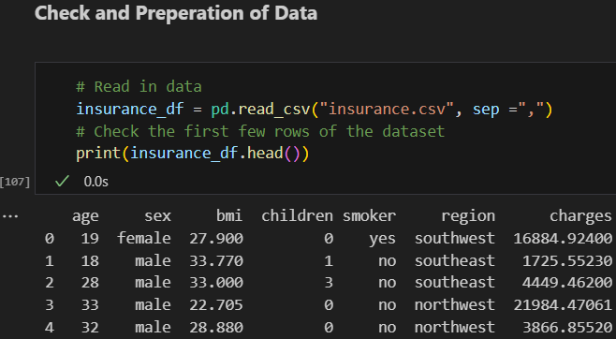
Steps of Data Cleansing
( ) Missing Values
( ) Duplicate Entries
( ) Outliers
( ) Inconsistent Formatting
( ) Incorrect Data Types
✔ String/Whitespace Issues
✔ Mismatched Data – short Excel check
( ) Scaling and Normalization Issues

Slide 5
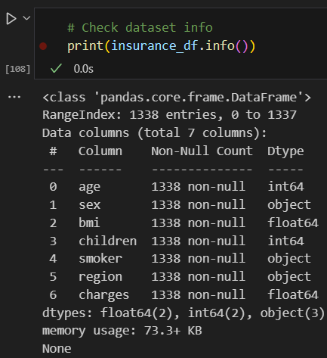
Steps of Data Cleansing
✔ Missing Values
( ) Duplicate Entries
( ) Outliers
✔ Inconsistent Formatting
✔ Incorrect Data Types
✔ String/Whitespace Issues
✔ Mismatched Data – short Excel check
( ) Scaling and Normalization Issues

Slide 6
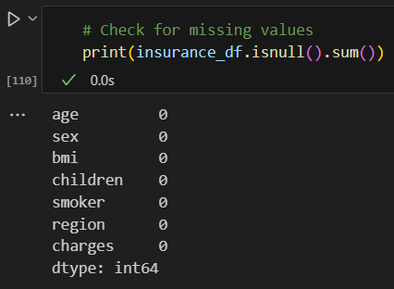
Steps of Data Cleansing
✔ Missing Values
( ) Duplicate Entries
( ) Outliers
✔ Inconsistent Formatting
✔ Incorrect Data Types
✔ String/Whitespace Issues
✔ Mismatched Data – short Excel check
( ) Scaling and Normalization Issues

Slide 7
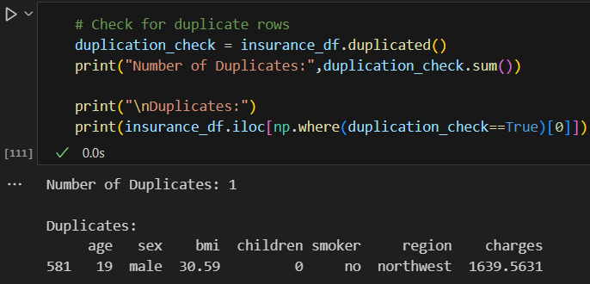
Steps of Data Cleansing
✔ Missing Values
✔ Duplicate Entries
( ) Outliers
✔ Inconsistent Formatting
✔ Incorrect Data Types
✔ String/Whitespace Issues
✔ Mismatched Data – short Excel check
( ) Scaling and Normalization Issues

Slide 8
Check of Distribution

Slide 9
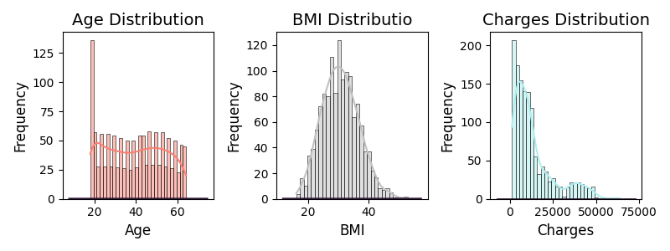
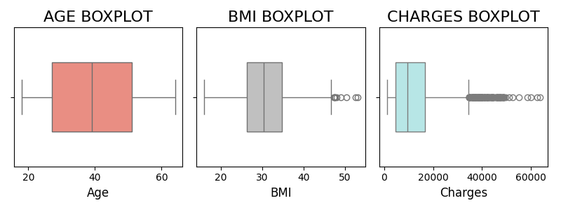
Check of distributions (1) + Outliers
Observation
Distribution
Even distribution in age
BMI: Gauss curve
Charges: great left skew
Outliers
9 Outliers at BMI
> 100 Outliers at Charges

Slide 10
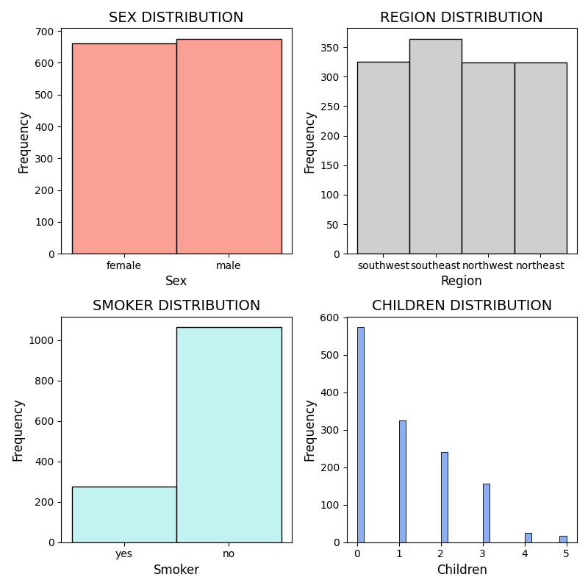
Check of distributions (2) + String Check
Observation
Relatively even distribution between sex and region
Uneven distribution between
Smokers
Children (w/ has a far higher concentration)

Slide 11
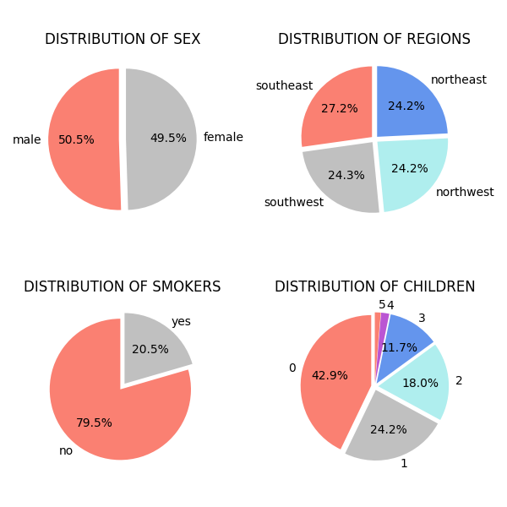
Check of distributions (3) Sex, Region, Smoker Children
Observation
Relatively even distribution between sex and region
Uneven distribution between
Smokers
Children (w/ has a far higher concentration)

Slide 12
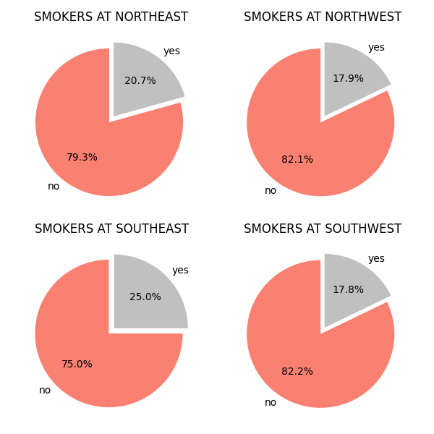
Check of distributions (4) (Non) Smokers per Sex & Region
Observation
No great variation of smokers by region
Small outlier: Southeast

Slide 13
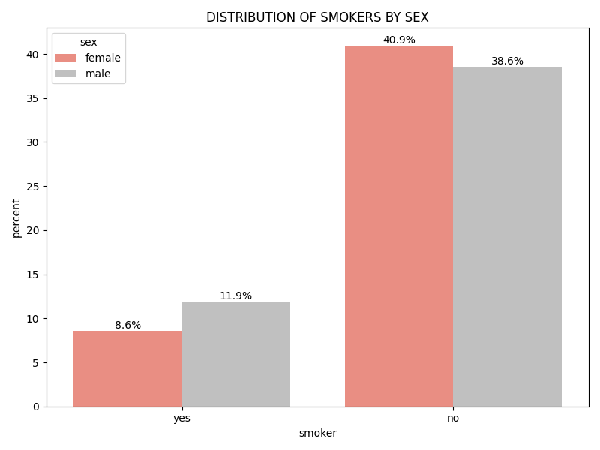
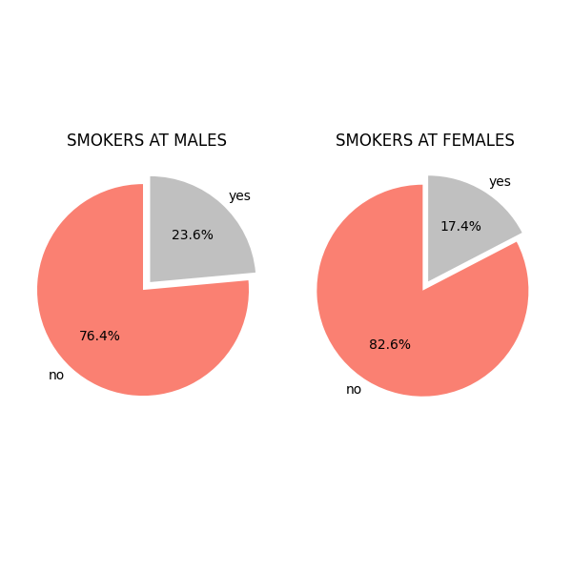
Check of distributions (5) (Non) Smokers per Sex & Region
Observation
Relatively even distribution of smokers at a certain sex
Males slightly higher than females

Slide 14
Check of Charges

Slide 15
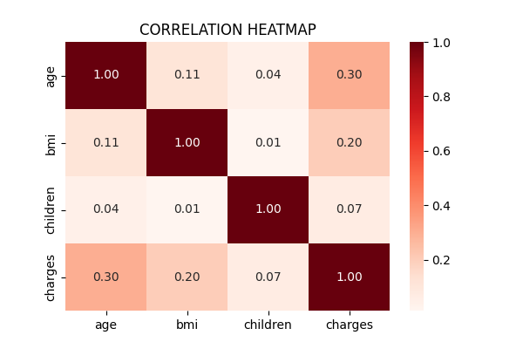
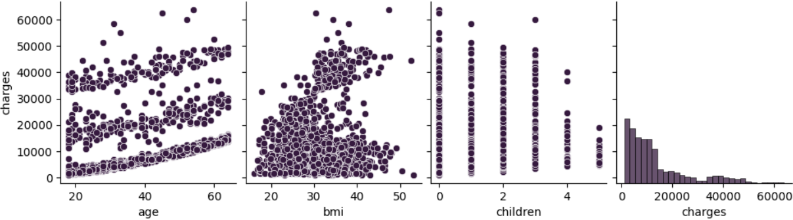
Check of Charges (1) Correlations
sns.pairplot(df_cleaned) plt.show()
Observation
Look on heatmap → lowest horizontal line
Greatest impact by age and BMI
Low impact by number of children

Slide 16
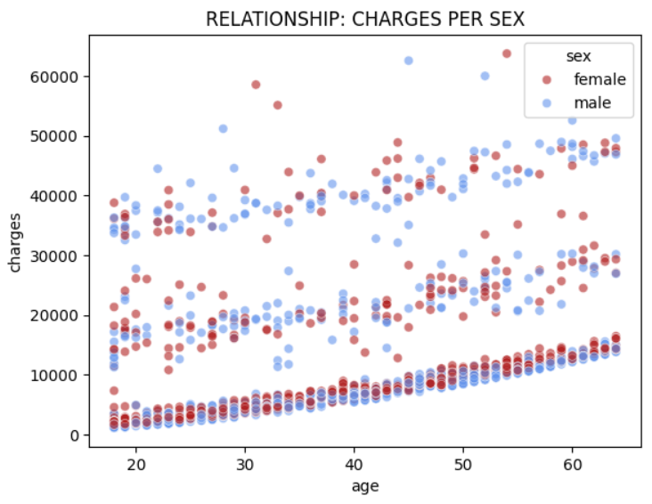
Check of Charges (2) Correlations
Observation
Impact by sex is evenly distributed by male and female
Age is a higher impact

Slide 17
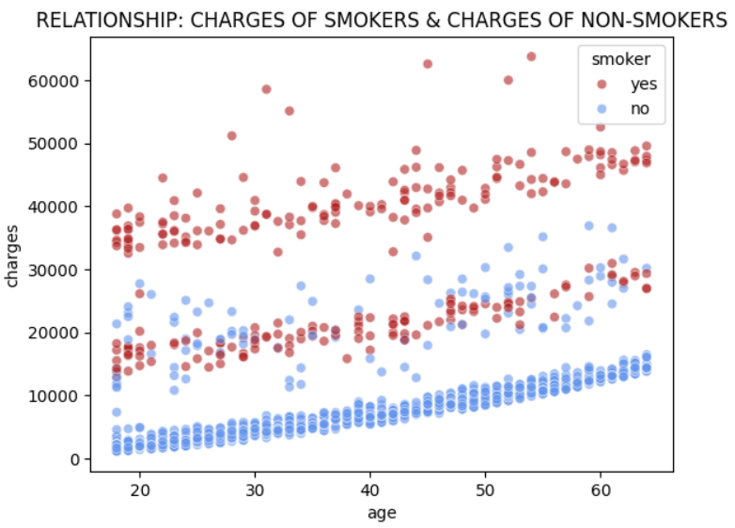
Check of Charges (3) Correlations
Observation
Critical impact by smoking
Age has an impact, too

Slide 18
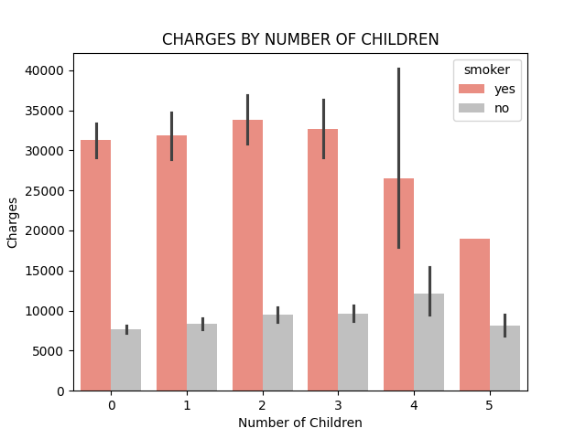
Check of Charges (4) Correlations
Observation
Number of children has almost no impact until a number of 3
Great decrease at 4 and 5 children
Great impact by smoking

Slide 19
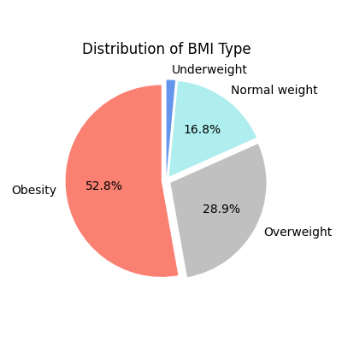
Check of Charges (5) Correlations
Clustering
Clustering of BMI according to current standards:
BMI > 18.5 → Underweight
18.5 < BMI < 25 → Normal Weight
25 =< BMI < 30 → Overweight
30 < BMI → Obesity
Observation
High percentage of obesity and overweight
Keep in mind: BMI one of the highest impacts on charges

Slide 20
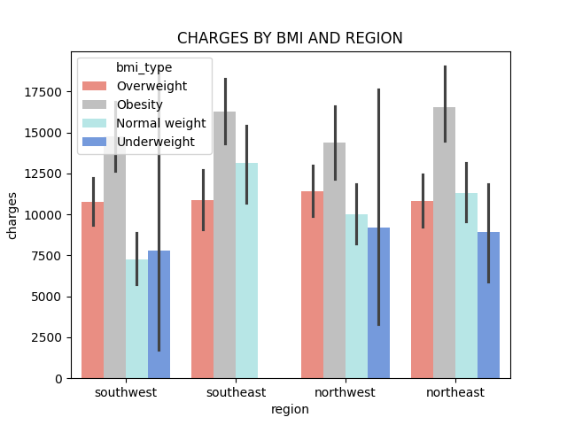
Check of Charges (6) Correlations
Observation
No underweight people in southeast
Highest charges for obesity
Tie 2nd highest charges for normal and overweight
Assumption: affect by smokers

Slide 21
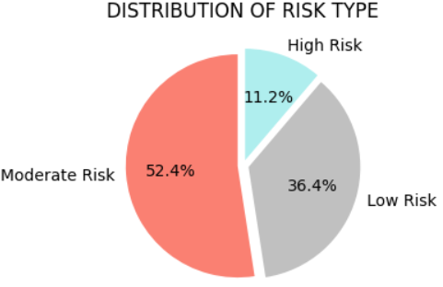
Check of Charges (7) Correlations
Clustering
Clustering to risk level:
High risk: Obesity + Smoker
Moderate risk: normal/overweight + smoker
Else: low risk
Clustering by age:
Age < 30 years
30 years < Age < 50 years
Age > 50 years

Slide 22
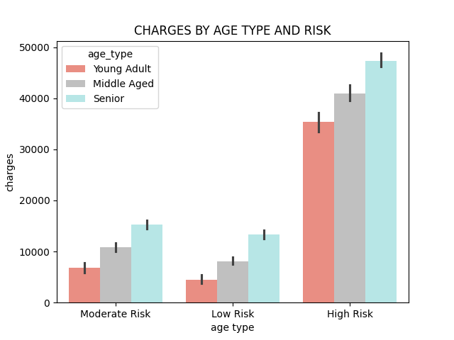
Check of Charges (8) Correlations
Observations
Charges increase with risk level
Age as greater impact

Slide 23
Key Findings
Findings (Data Distribution):
Outliers:
BMI: 9
Charges: > 100 + Skew to the right
More or less balanced distribution per
Age
Sex
Smokers
Region
Insights
Smoking has a high impact on charges
Also, obesity affects charges heavily
Charges rise continuously per age
Regional distribution of the factors including the sex mentioned above is relatively evenly done
Low impact on charges by the number of children

Slide 24
Data Cleansing
Part 2

Slide 25
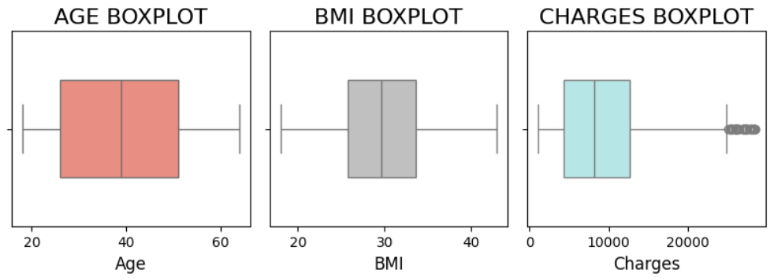
Steps of Data Cleansing
✔ Missing Values
✔ Duplicate Entries
✔ Outliers
✔ Inconsistent Formatting
✔ Incorrect Data Types
✔ String/Whitespace Issues
✔ Mismatched Data
( ) Scaling and Normalization Issues

Slide 26
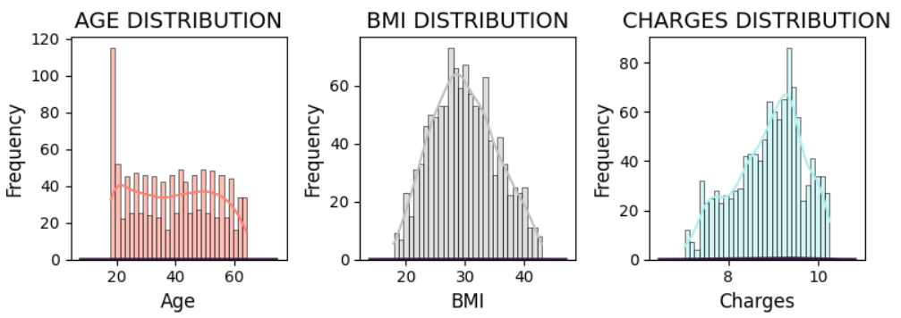
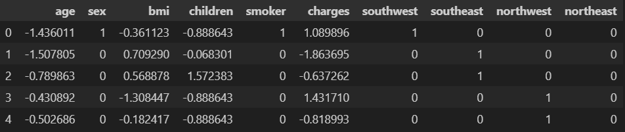
Steps of Data Cleansing
✔ Missing Values
✔ Duplicate Entries
✔ Outliers
✔ Inconsistent Formatting
✔ Incorrect Data Types
✔ String/Whitespace Issues
✔ Mismatched Data
✔ Scaling and Normalization Issues

Slide 27
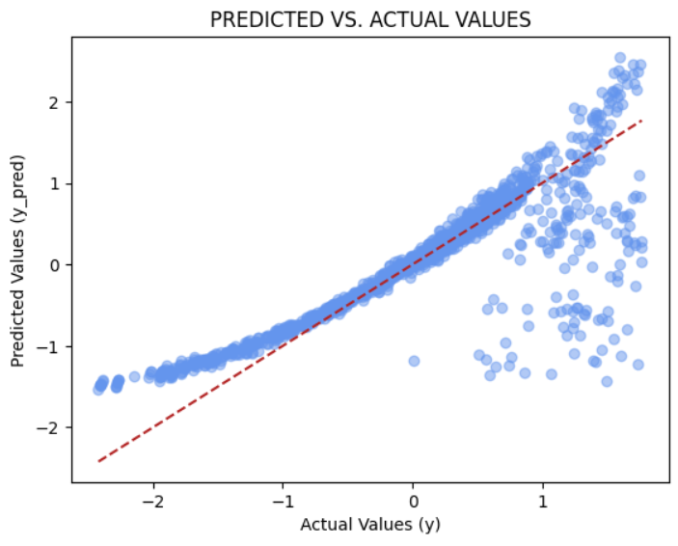
Comparison: Predicted vs. Actual Values

